Slide 1

KisanSe: Connecting Farmers Directly with Consumers
Empowering Sustainable Agriculture and Fair Marketplaces

Slide 2
Introduction
What is KisanSe?
A web application that bridges the gap between farmers and consumers, promoting direct-to-consumer sales.
Aims to support sustainable agriculture, reduce food costs, and ensure fair earnings for farmers.

Slide 3
Mission and Vision
Mission: Promote sustainable farming by empowering farmers and enabling consumers to make healthier, more informed choices.
Vision: To create a transparent and equitable marketplace that benefits local communities, consumers, and the environment.

Slide 4
Problem Statement
Challenges Farmers Face:
Low earnings due to intermediaries.
Limited access to a broader customer base.
Challenges Consumers Face:
Lack of transparency in food sourcing.
High costs due to middlemen

Slide 5
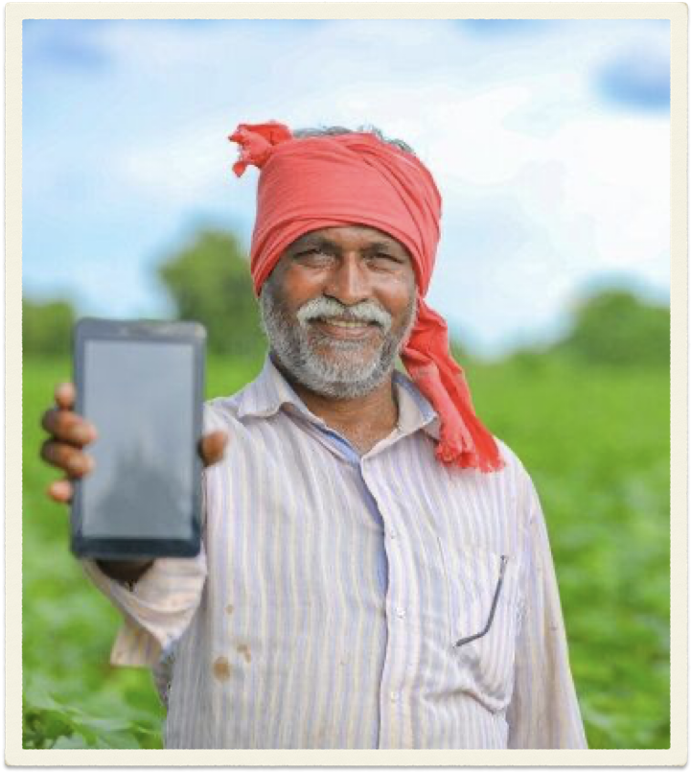
Solution – KisanSe
Direct connection between farmers and consumers.
A transparent, fair, and efficient platform that benefits both parties.
Secure payment processing and reliable logistics.

Slide 6
Key Features
Farmer-to-Consumer Sales: Direct sales channel for farmers.
User-Friendly Interface: Intuitive design using HTML, CSS, and JavaScript.
Efficient Backend: Built on PHP for speed and reliability.
Payment Integration: Secure PayPal and bank transfer options.
Admin Dashboard: Manage users, products, and transactions effectively.

Slide 7
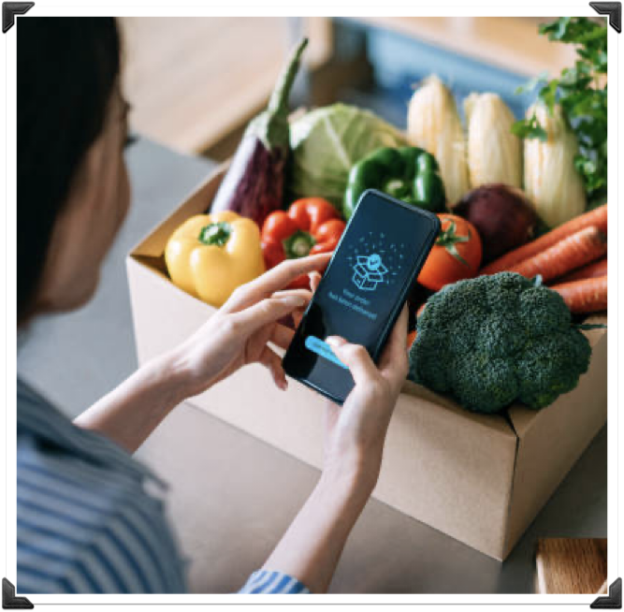
Platform Overview
Customer Interface: Browse products, place orders, and communicate with farmers.
Farmer Interface: List products, manage orders, and access support.
Admin Interface: Oversee transactions, manage compliance, and handle platform logistics.

Slide 8

How It Works
Browse Products: Consumers can explore various farm goods.
Place Orders: Orders placed directly with farmers.
Secure Payments: Processed via integrated gateways.
Delivery Management: Seamless logistics support for order fulfillment.

Slide 9

Technology Stack
Frontend: HTML, CSS, JavaScript.
Backend: PHP.
Payments: PayPal integration.
Hosting: InfinityFree for cost-effective deployment.

Slide 10

Conclusion
KisanSe empowers local farmers and promotes sustainable practices.
Through fair pricing and transparent transactions, it creates a mutually beneficial ecosystem.
Join KisanSe in the journey towards a healthier, more sustainable food system!
Demo: KisanSe

